Slide 1

Microsoft Summer Internship Placement Guide

Slide 2
Software Engineering Intern - Role Summary
Microsoft Corporation (MS) is an American multinational technology company with headquarters in Redmond, Washington. It develops, manufactures, licenses, supports and sells computer software, consumer electronics, personal computers, and related services. Its best known software products are the Microsoft Windows line of operating systems, the Microsoft Office suite, and the Internet Explorer and Edge web browsers. Its flagship hardware products are the Xboxvideo game consoles and the Microsoft Surface lineup of touchscreen personal computers
Microsoft was founded by Bill Gates and Paul Allen on April 4, 1975

Slide 3
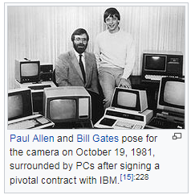
Paul Allen & Bill Gates – Founders of Microsoft

Slide 4

Microsoft – Mission

Slide 5
Microsoft – Popular Products
Windows
Azure
Bing
Office Suite
SQL Server
Visual Studio

Slide 6
Microsoft – Office Suite of Products
Word
Visio
Excel
Project
PowerPoint
Outlook

Slide 7
Microsoft – Developer Tools
Dot Net
Visual Studio
Power BI
SQL Server

Slide 8
Microsoft Azure – Cloud Computing Tools
Virtual Machines
Machine Learning
Azure Cosmos DB
Functions (Serverless)
Blockchain Workbench
Cognitive Services

Slide 9
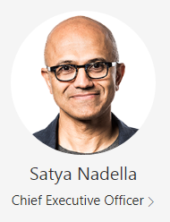
Satya Nadella named CEO of Microsoft in 2014

Slide 10
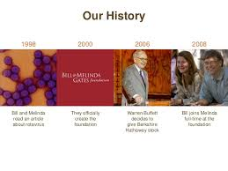
Bill & Melinda Gates Foundation

Slide 11

Bill Gates & Melinda Gates

Slide 12

Bill & Melinda Gates Foundation - Purpose

Slide 13

Bill & Melinda Gates – Accepting Lasker-Bloomberg Public Service Award

Slide 14
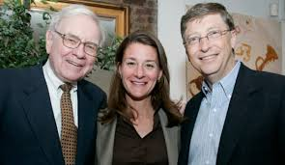
Giving Pledge – Over 100 Billionaires including Warren Buffet are giving away the majority of their wealth

Slide 15

Bill & Melinda Gates – In Africa

Slide 16

Melinda Gates – In India

Slide 17

Bill & Melinda Gates Foundation

Slide 18

Bill & Melinda Gates Foundation

Slide 19

Bill & Melinda Gates Foundation

Slide 20

Bill & Melinda Gates Foundation

Slide 21
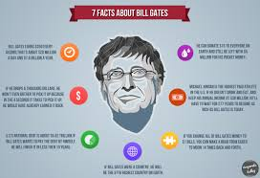
Facts about Bill Gates

Slide 22
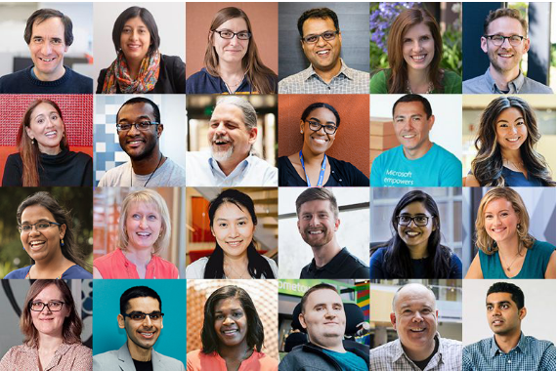
Microsoft – Strongly believes in Diversity

Slide 23
Microsoft Summer Internship - Recruitment Process
Online Coding Test
HR Interview
2/3 Technical Interview (s)
Fly Round

Slide 24
Software Engineering Intern - Role Summary
At Microsoft, our interns work on projects that matter – and your team will rely on your skills and insights to help deliver those projects to market. You’ll get the opportunity to work on real projects and have fun along the way. This is your chance to show off your skills and work on cutting-edge technology in the 2 months Summer internship (May – July 2019). We offer you an internship in some of the coolest product areas. Imagine yourself as a Microsoft intern. Join Microsoft today, and help us shape the business of tomorrow.

Slide 25
Software Engineering Intern - Responsibilities
Planning
o Understanding customer requirements.
o Assisting with project planning, scoping, prioritization.
o Providing estimates; Identifying task ownership.
Design
o Creating simple, flexible and comprehensive designs.
o Providing and soliciting design feedback.
Implementation
o Writing quality code at source.
o Authoring validation tests; Providing timely issue resolutions.

Slide 26
Traits Microsoft looks for in a Candidate
High Intelligence
Desire to work hard
Entrepreneureal Spirit
Desire to Excel
Passion for Technology
Rock Solid Skills

Slide 27
Out of 3 Coding Questions
One Questions is likely from Linked Lists/Stacks/Queues
One Question is likely from Arrays/Strings
One Question is likely from Binary trees/Binary Search trees

Slide 28
Extremely Important Topics for Coding Practice
Important
Stacks
Linked Lists
Trees
Queues
Arrays/Strings

Slide 29
Extremely Important Tips
Tips
GeeksforGeeks Microsoft Archive
Practice Questions on Strings, Linked Lists, Stacks, Queues & Trees
Ensure that as many test cases pass. The test cases are usually in increasing order of complexity
If you know of an efficient algorithm then implement it. But do not spend too much time on any specific question

Slide 30
Extremely Important Tips
Tips
Time is precious. Coding Test also meant to evaluate your speed. So you need lot of practice
Graphs are generally not asked in Coding Tests as they involve a lot of time to implement
In some of the questions they may tell you to solve it with a specific time complexity say O(n). These are the tricky ones
Go through as many problems as possible in GeeksforGeeks. Atleast you will be aware of the Problem Solving approach

Slide 31
Interview Tips from Microsoft

Slide 32

Software Engineering Intern - Role Summary

Slide 33
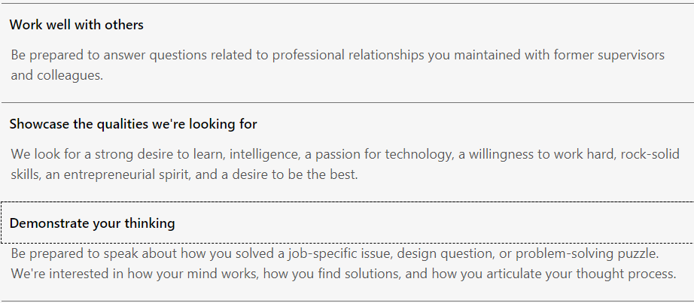
Software Engineering Intern - Role Summary

Slide 34
Software Engineering Intern - Role Summary

Slide 35
Bit Manipulation Problems

Slide 36
Sample Problems
You are given two 32-bit numbers, N and M, and two bit positions, i and j. Write a method to set all bits between i and j in N equal to M (e.g., M becomes a substring of N located at i and starting at j).
EXAMPLE:
Input: N = 10000000000, M = 10101, i = 2, j = 6
Output: N = 10001010100
1
0
0
0
0
0
0
0
0
0
0
1
0
1
0
1
1
0
0
0
1
0
1
0
1
0
0

Slide 37
Sample Problems
Write a function to determine the number of bits required to convert integer A to integer B.
Input: 31, 14
Output: 2
0
0
0
0
0
0
1
1
1
1
1
0
0
0
0
1
0
0
1
1
1
0

Slide 38
Array Problems

Slide 39
Sample Problems
Given an array, print all sub arrays in the array which has sum 0
This problem can be generalized in where they can say find all sub arrays whose sum is k where can be 0, +ve or -ve
6
3
-1
-3
4
-2
2
4
6
-12
-7

Slide 40
Sample Problems
6
3
-1
-3
4
-2
2
4
6
-12
-7
6
9
8
5
9
7
9
13
19
7
0

Slide 41
Sample Problems
You are given an array of integers (both positive and negative). Find the continuous sequence with the largest sum. Return the sum.
EXAMPLE
Input: {2, -8, 3, -2, 4, -10}
Output: 5 (i.e., {3, -2, 4} )
2
-8
3
-2
4
-10
-2
-3
4
-1
-2
1
5
-3

Slide 42
Sample Problems
Given an array A[] consisting 0s, 1s and 2s, write a function that sorts A[]. The functions should put all 0s first, then all 1s and all 2s in last.
0
1
1
0
1
2
1
2
0
1
2

Slide 43
String Problems

Slide 44
Sample Problems
Remove duplicates in string in place in O(n) time complexity

Slide 45
Sample Problems
Remove Alternate Duplicate characters from a char array you have to do it in Place. Like keeping only the odd occurrences of each character. Example:
Input: “you got beautiful eyes”
Output: ”you gtbeaiful es”
Allowed Time Complexity was O(n) and Space Complexity was O(1)

Slide 46
Sample Problems
Given a string which consists only of 0, 1, A, B, C where
A = AND B = OR C = XOR
Calculate the value of the string moving from left to right assuming no precedence of the operators ( all operators have equal precedence )
For string 0A1B0C1 ( 0 AND 1 OR 0 XOR 1 )
Value is 1

Slide 47
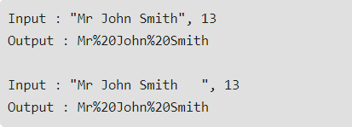
Sample Problems
Write a method to replace all the spaces in a string with ‘%20’. You may assume that the string has sufficient space at the end to hold the additional characters, and that you are given the “true” length of the string.
The method should modify the string in place ( without using additional strings )

Slide 48
Linked List Problems

Slide 49
Sample Problems
Implement an algorithm to delete a node in the middle of a single linked list, given only access to that node.
EXAMPLE
Input: the node ‘c’ from the linked list a->b->c->d->e
Result: nothing is returned, but the new linked list looks like a->b->d->e

Slide 50
Sample Problems
Implement an algorithm to find the intersection point of 2 Linked Lists

Slide 51
Sample Problems
Given a linked list and two integers M and N. Traverse the linked list such that you retain M nodes then delete next N nodes, continue the same till end of the linked list.
Input: M = 2, N = 2 Linked List: 1->2->3->4->5->6->7->8 Output: Linked List: 1->2->5->6

Slide 52
Stack Problems

Slide 53
Sample Problems
Write a function to check whether the parenthesis ( “( )”, “{ }” , “[ ]” ) in a given string are balanced or not

Slide 54
Queue Problems

Slide 55
Sample Problems
Implement a Queue using 2 Stacks

Slide 56
BST Problems

Slide 57
Sample Problems
Given a BST, a min value and a max value, delete the nodes of the BST having data smaller than min value and greater than max value. If minvalue = 3 and maxvalue = 13 then resultant tree is shown on the right
10
10
8
13
8
13
2
11
11
15

Slide 58
Sample Problems
Given a binary tree and data value of a node. The task is to find the sum of cousin nodes of given node. If given node has no cousins then return -1. Note: It is given that all nodes have distinct values and the given node exists in the tree.
Key is 15 then cousin nodes are 2 and 11 and the sum is 13 Key is 3 then there are no cousin nodes so return -1
1
3
7
2
11
15

Slide 59
Sample Problems
Connect all leaf nodes of a binary tree to make a LL without making any changes to the structure of the node
1
3
7
2
11
6
15

Slide 60
Sample Problems
Given a Binary Search Tree (BST) and a range [min, max], remove all keys which are outside the given range. The modified tree should also be BST. For example, consider the following BST and range [-10, 13].
6
-13
14
-8
13
15
7

Slide 61
Least Common Ancestor – In a Binary Search Tree (BST)
Given values of two values n1 and n2 in a Binary Search Tree, find the Lowest Common Ancestor (LCA). You may assume that both the values exist in the tree.
LCA(5, 13) = 10 LCA(5, 2) = 5 LCA(2, 8) = 5 LCA(2, 15) = 10
10
5
13
2
8
15

Slide 62
Distance between 2 Nodes – In a Binary Search Tree (BST)
LCA(5, 13) = 2 LCA(5, 2) = 1 LCA(2, 8) = 2 LCA(2, 15) = 4
10
5
13
2
8
15

Slide 63
Binary Tree with minimal height
Given a sorted (increasing order) array, write an algorithm to create a binary tree with minimal height.

Slide 64
Sum of cousin nodes – In a Binary Tree (BT)
Given a binary tree and data value of a node. The task is to find the sum of cousin nodes of given node. If given node has no cousins then return -1. Note: It is given that all nodes have distinct values and the given node exists in the tree.
10
5
13
2
8
15

Slide 65
Sum of cousin nodes – In a Binary Tree (BT)
Convert the Binary Tree(BT) to a BST
8
10
10
4
4
12
15
2
2
12
8
15

Slide 66
Check whether the Binary Tree is a Full Binary Tree
Convert the Binary Tree(BT) to a BST ( A, B & C are Full Binary tree and D and E are not )
10
8
E
4
10
A
4
10
4
15
2
B
4
12
8
8
10
C
4
10
D
4
15
15
2
7
12
2
12

Slide 67
Print the path between any 2 nodes in a BST
Convert the Binary Tree(BT) to a BST ( A, B & C are Full Binary tree and D and E are not )
Path between 15 and 7 is 15->10->8->4->7
Path between 15 and 2 is 15->10->2
Path between 15 and 10 is 15->10
8
10
4
15
2
7
12

Slide 68
Print the top view of a Binary Tree
2 15 10 8 4 12 3 1
8
10
4
15
6
7
12
21
3
18
1
2

Slide 69
Java Coding Tips – Performance Related

Slide 70
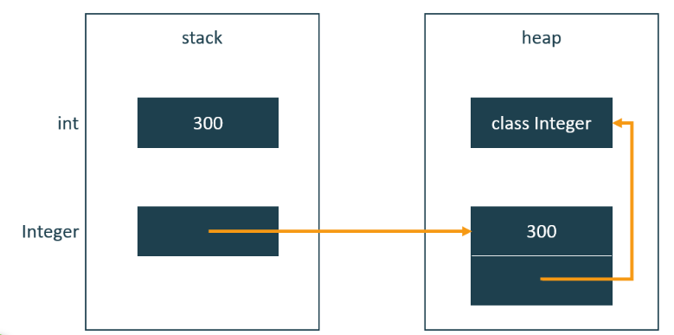
Use Primitives instead of Wrapper Objects – int instead of Integer

Slide 71
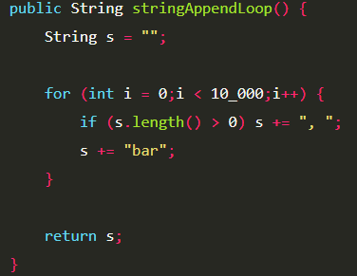
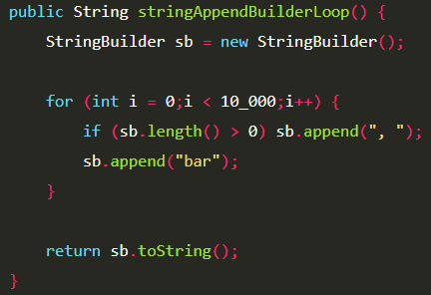
Use StringBuilder instead of String for concatenation operations as StringBuilder object is mutable and String objects are immutable

Slide 72
Java String Vs String Buffer Vs String Builder – Which one to use
If a string is going to remain constant throughout the program, then use String class object because a String object is immutable.
If a string can change (example: lots of logic and operations in the construction of the string) and will only be accessed from a single thread, using a StringBuilder is good enough.
If a string can change, and will be accessed from multiple threads, use a StringBuffer because StringBuffer is synchronous so you have thread-safety.

Slide 73
Java Arrays Vs ArrayList
Resizability
Arrays have a static or fixed size but ArrayList have a capacity instance attribute which indicates the size of the ArrayList. As elements are added to an ArrayList its capacity grows automatically.
Performance
Performance depends on the operation: for adding or fetching {add() and get()} methods Array and ArrayList have almost same performance as for ArrayList object these operations run in constant time. But the resize method of ArrayList slow down the performance as it will use a temporary array to copy elements from the old array to new array.
Primitives
The array can contain both primitive data types as well as objects of a class depending on the definition of the array. However, ArrayList only supports object entries, not the primitive data types.

Slide 74
Java Arrays Vs ArrayList
Iterating:
ArrayList provides iterators to iterate through its elements. You can also use for loop or for-each loop to iterate an ArrayList. But to iterate an array, you have to use either for loop or for-each loop.
Multi-dimensional:
An array can be multi-dimensional, while ArrayList is always single dimensional.

Slide 75
Recursion
Use Recursion only when the alternative iterative algorithm is very complex such as tree traversal algorithms. Recursion is costly in both time and space and hence should avoid recursion if you want your code to be efficient

Slide 76
Built-In Library Functions
On advantage of Java over C/C++ is the availability of a large number of library functions. These functions are coded efficiently and tested thoroughly. So you must make use of them as much as possible. The more you become familiar with the library functions the better.
Please read the following articles :
https://www.geeksforgeeks.org/java-tricks-competitive-programming-java-8/

Slide 77
Time Limit Exceeded(TLE) Error in Java – Tips to avoid
Avoid using Scanner Class and try to use BufferedReader class for reading Input
Try to use StringBuffer class in case you have to print large number of data
Read this article to know why Buffered Reader is faster and smarter than Scanner
https://www.geeksforgeeks.org/difference-between-scanner-and-bufferreader-class-in-java/

Slide 78
Time Limit Exceeded(TLE) Error in C++ – Tips to avoid
Avoid using cin and cout and try to use
scanf and printf for reading Input
Read this article to understand why cin and cout are very slow compared to scanf and printf https://www.geeksforgeeks.org/cincout-vs-scanfprintf/

Slide 79
Time Limit Exceeded(TLE) Error in Python – Tips to avoid
Adding the following 2 lines to the beginning of the file to speed up the execution
import psyco psyco.full()

Slide 80
Time Limit Exceeded(TLE) Error
Examine your algorithm and try to reduce the time complexity. Say if you are using bubble sort try to switch to an efficient algorithm such as quicksort
Input/Output takes a lot of time and examine how you are doing input/output and try optimizations around that
Using built-in library functions and efficient programming constructs
Examine your I/O functions and use appropriate ones for faster I/O

Slide 81
Preparation Resources
GeeksforGeeks Website
Cracking the Coding Interview
Programming Interviews Exposed
Coding Platforms HackerRank/ HackerEarth/ CodeChef

Slide 82
Links - General
Tips & Tricks for Competitive Programming – Set 1
https://www.geeksforgeeks.org/tips-and-tricks-for-competitive-programmers-set-1-for-beginners/
Tips & Tricks for Competitive Programming – Set 2
https://www.geeksforgeeks.org/tips-and-tricks-for-competitive-programmers-set-2-which-language-should-be-used-for-competitive-programming/
Bit Tricks for Competitive Programming
https://www.geeksforgeeks.org/bit-tricks-competitive-programming/
Bit Wise Hacks for Competitive Programming
https://www.geeksforgeeks.org/bitwise-hacks-for-competitive-programming/

Slide 83
Links - General
How to overcome Time Limit Exceeded(TLE) Error ?
https://www.geeksforgeeks.org/overcome-time-limit-exceedtle/

Slide 84
Links for C/C++ Programmers
C++ Tricks for Competitive Programming
https://www.geeksforgeeks.org/c-tricks-competitive-programming-c-11/
Fast I/O for Competitive Programming – C/C++
https://www.geeksforgeeks.org/fast-io-for-competitive-programming/
Most Common errors in C++ for beginners (while programming on CodeChef, HackerRank, HackerEarth)
https://www.youtube.com/watch?v=vtf9g_YGg8o

Slide 85
Links for Java Programmers
Fast I/O in Java for Competitive Programming
https://www.geeksforgeeks.org/fast-io-in-java-in-competitive-programming/
Java Tricks for Competitive Programming
https://www.geeksforgeeks.org/java-tricks-competitive-programming-java-8/
How to get rid of Java TLE problem ?
https://www.geeksforgeeks.org/how-to-get-rid-of-java-tle-problem/
Time Limit Exceeded (TLE) - Learn this trick to pass all testcases in Competitive Coding
https://www.youtube.com/watch?v=2frmG3Z_PRo

Slide 86
Links for Python Programmers
Optimization tips for Python Programmers
https://www.geeksforgeeks.org/optimization-tips-python-code/
10 Essential Python Tips & Tricks
https://www.geeksforgeeks.org/10-essential-python-tips-tricks-programmers/
30 Essential Python Tips & Tricks
https://www.techbeamers.com/essential-python-tips-tricks-programmers/
Python Tricks for Competitive Coding
https://www.geeksforgeeks.org/python-tricks-competitive-coding/
Why Python is best suited for Competitive Coding ?
https://www.geeksforgeeks.org/python-best-suited-competitive-coding/

Slide 87
You
All
The
Best
Wish

